Slide 1

Facebook Inc.
Website : www.facebook.com
data upto 2019 quarter 4
Generated on 02-16-2020

Slide 2

Heineken
Website : www.theheinekencompany.com
data upto 2019 quarter 4
Generated on 02-16-2020

Slide 3
Company introduction
Description of the company
The world's most international premium beer. Our content is intended for people of Legal Drinking Age, and shouldn't be shared with those who aren't. Please don't post inappropriate comments, thoughts or suggestions on our pages. If you do post somethi...

Slide 4
Company introduction continued
Details of the company
Year found : 1873
Company type : Public Company
Latest_revenue in millions : 26854.818823085
Revenue currency : EUR
Address : 21 Tweede Weteringplantsoen, Amsterdam, NH, 1017 ZD, NL
CEO : van Boxmeer, Jean-Francois
Country : NL

Slide 5
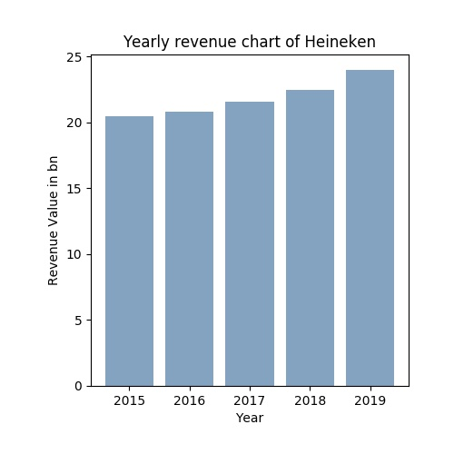
Yearly revenue of the company
For many companies, revenue is largely equivalent to sales, but can also include other sources of income such as royalties or returns on investment.
For a fuller picture of how a company’s revenue has changed over time, check out the revenue growth metric.

Slide 6
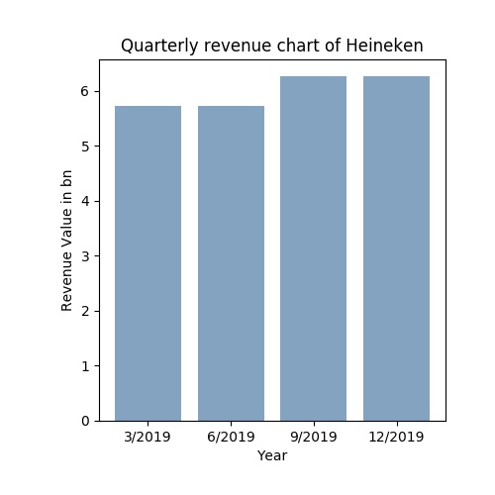
Yearly revenue of the company
For many companies, revenue is largely equivalent to sales, but can also include other sources of income such as royalties or returns on investment.
For a fuller picture of how a company’s revenue has changed over time, check out the revenue growth metric.

